Slide 1
SCREENSHOTS
Building Bus Reservation System using Python and Django
(vaishnavi_5113)

Slide 2
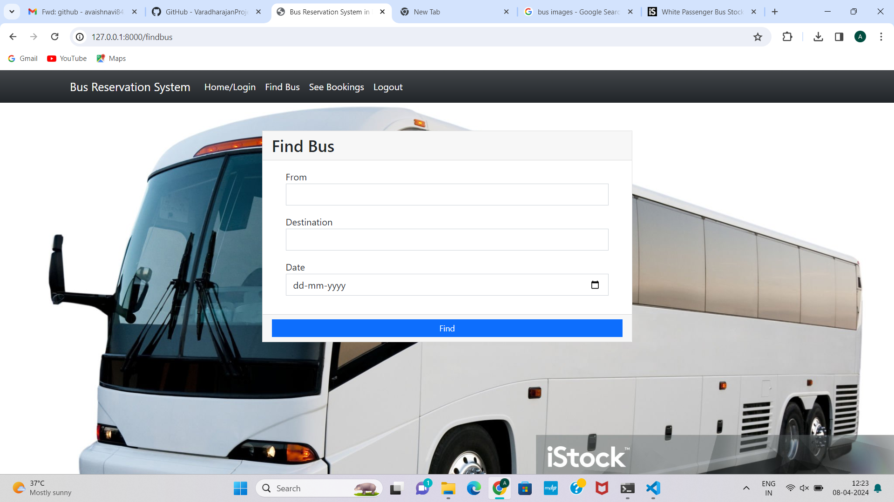
FINDING BUS

Slide 3
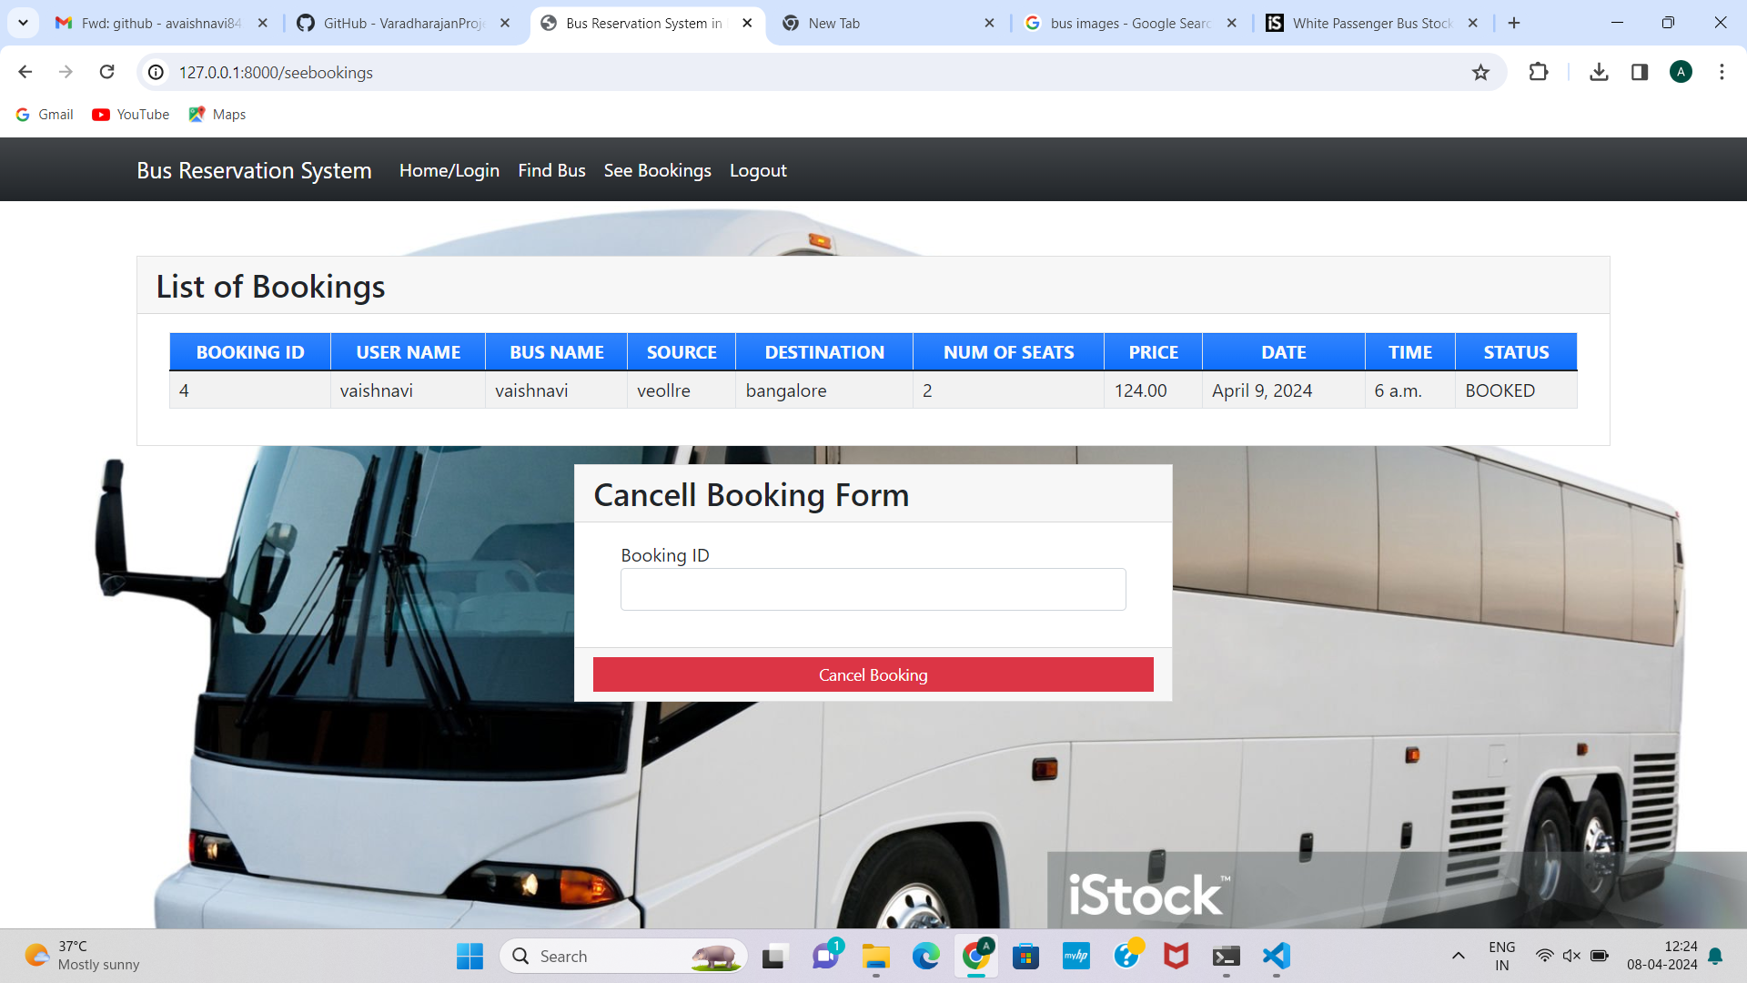
BOOKINGS

Slide 4
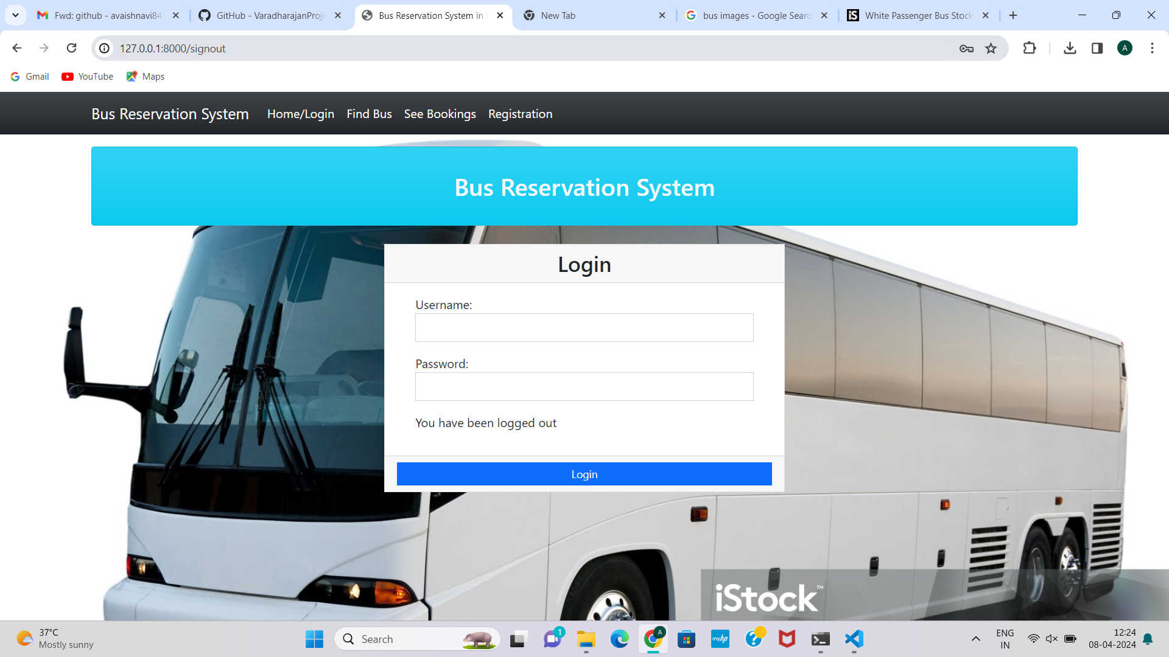
LOGIN PAGE

